Slide 1
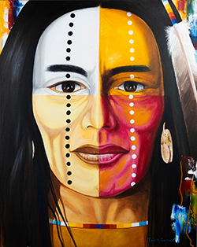

TEMAGAMI FIRST NATION
TAA
Community Conversation
WEALTH CREATION THROUGH MODERN TRUSTS

Slide 2

Agenda
Who we are
Background
Trust Basics
Modern Trust Designs

Slide 3
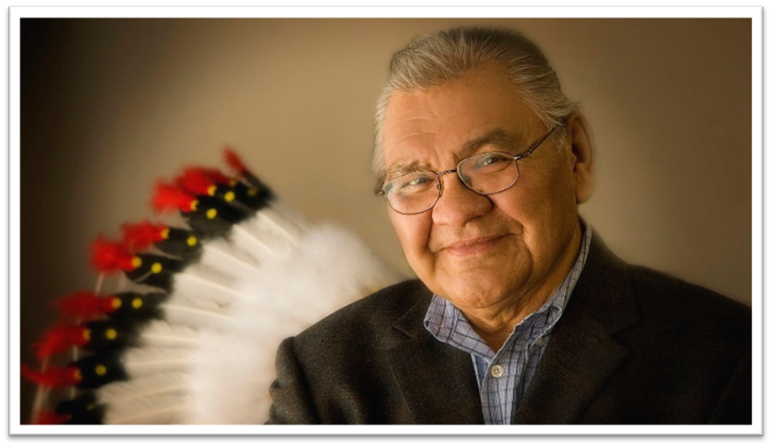
Who We Are
Canada’s oldest and largest First Nation owned, federally regulated financial institution
Fully owned by Samson Cree Nation of Maskwacis, Alberta
Driven by a vision to bring unique financial solutions to the needs of First Nations across Canada
Hon. Chief Victor Buffalo
Founder, former Chairman of the Board, and former Director of Peace Hills Trust

Slide 4
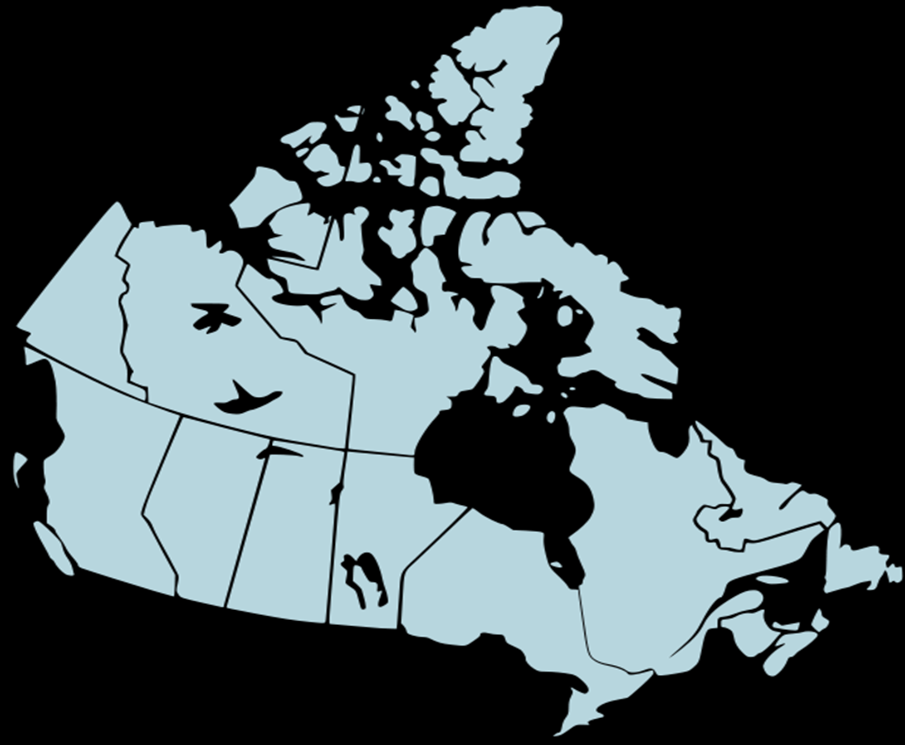
Who We Are
FIRST NATION RELATIONSHIPS
135
TRUST RELATIONSHIPS
91
ASSETS UNDER MANAGEMENT
$5 B
We believe that each Nation is unique and the trust that is developed for
you should be unique to the goals and vision of your Nation.
At Peace Hills there is no “one size fits all”!

Slide 5
Trusts - Why have Them?
Trust are good vehicles in and of themselves:
  They offer protection from creditors
  They preserve the capital and provide long term cash flow
  A way to turn a non-renewable resource into a renewable resource
Stops the fear that the funds may not be used for the purpose for which they were intended

Slide 6
What is a Trust? It’s a Legal Relationship!
SETTLOR
TRUSTEES
Corporate Trustee
Community Trustees
Hybrid (combination of the 2)
TEMAGAMI
BENEFICIARIES
Members
Represented by Chief and Council
6

Slide 7
A Trust as a Financial Vehicle
TEMAGAMI | TRUSTEES
Community decides what to do with the funds Uses and decision making need to be addressed by the First Nation | Annual Payment
Canada
Income
Account
Trust Account
Investments
Initial Uses
Remaining Capital
The Trustees have no role or responsibility in determining how the funds are spent in the community.
The decision to determine how to spend the annual payment is left up to the community – which will need to be dealt with separately.

Slide 8
Planning for a Settlement
Factors that can influence the type of Trust Agreement:
      Amount of $
      Uses of the Trust Property
      Decision making
      Costs to administer the Trust

Slide 9
How Does Money Work in a Trust?
CAPITAL | REVENUE
Capital is the money deposited into the Trust Account | Is the money made from the capital
6%
4%
1%
Total Payments to Nation over 30 Years $139,139,566 – Trust Balance after 30 years $134,784,892

Slide 10
Rules for Uses of the Funds
CAPITAL | REVENUE
Trusts have rules on how funds are withdrawn from the capital. This is called an Encroachment or Dipping into the capital | Trusts have rules on how the revenue payment is issued to the Nation. This is called the Annual Income.

Slide 11
Initial Costs
Examples of initial expenses are:
Legal fees, incurred by the Nation in researching, preparing, negotiating and ratifying the settlement claim, to the extent that the same are not previously covered by the Settlement Agreement.
Personal Cash Distributions (challenges)
Debt Pay down
Possible other initial uses?
CAPITAL
USES

Slide 12
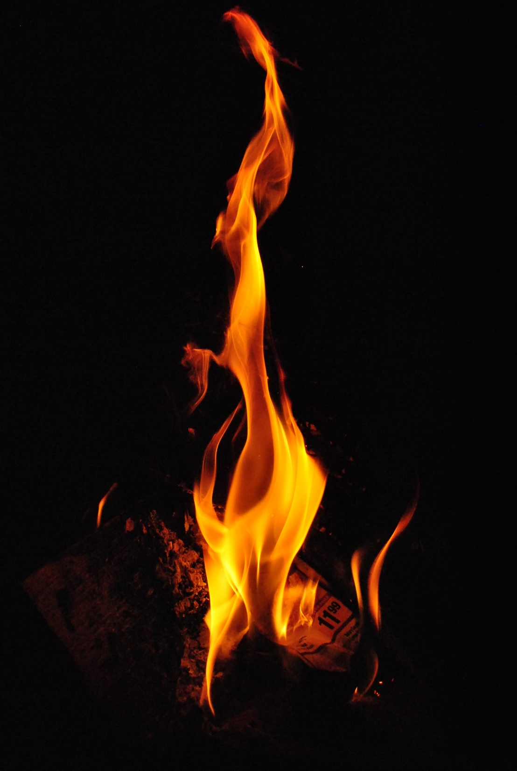
Emergencies
Would you want a rule to be able to dip into capital for an emergency?
Must exhaust all other avenues first?
Repaid before more can be drawn upon?
CAPITAL
USES

Slide 13
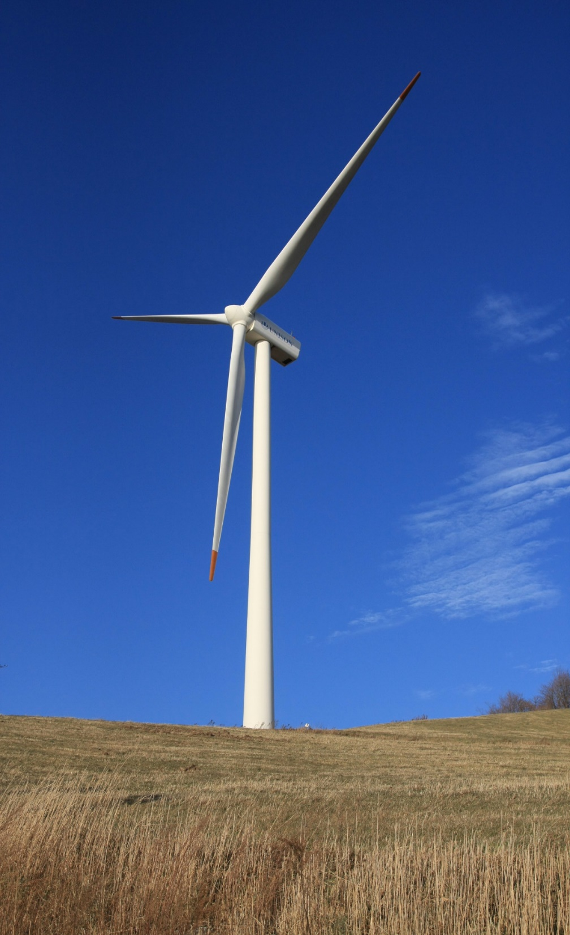
What about Land Purchases, Community or Economic Development
CAPITAL
USES
Do you want to have rules to drawdown on the capital for special purposes?
If so, how much and how often?
Should there be set limits?

Slide 14
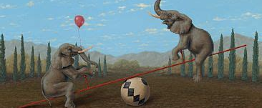
ENCROACHMENTS (dipping into) CAPITAL
BUT once it is gone – it’s gone and you lose that income forever.

Slide 15
BORROWING FROM THE TRUST
3
AT YEAR END, TRUST PAYS INCOME BACK TO THE NATION
TFN
TRUST
1
PROVIDES LOAN/FINANCING
REPAYS PRINCIPAL WITH INTEREST
2
TFN borrows from the Trust and provides the holding company with a share holders loan so the holding company can purchase the Lanark parcel in Ottawa.
TFN uses part of the annual income to repay the loan (principal plus interest) to the Trust.
At the end of each year the Trust returns the interest portion of the loan payment back to TFN as part to that year’s annual income payment.
EC DEV CORP
15

Slide 16
COMPARISON
(with dipping into Capital)

Slide 17
Rules for the Annual Income
Outside of Trust
Financial Polices and Bylaws.
Community Comprehensive Community Plan.
Built into the Trust
Consults with Members at least two times in the spring regarding how the annual payments will be spent.
Yearly audit on how the annual payment has been used and provides Members with details.

Slide 18
Powers & Duties
POWERS | DUTIES
Hire Investment Managers | Develop Invest policy
Hire Accountants | Monthly Financial Reporting
Hire Lawyer | Quarterly Newsletters
 | Annual Reports & Audits
 | Regular Meetings

Slide 19
Taxation
A FN Trust is neither a person nor a First Nation and must pay tax on any retained income in the Trust at the end of every year.
There are ways to avoid paying tax.
While taxation is important, it should not be the overriding factor in determining the plan for the Trust.

Slide 20
How Long Should the Trust Last?
No right or wrong answer.
Many First Nation Trusts are set up to last for 100 years.
Hard to know what the needs of the Nation will be in 100 years.
When the Trust ends it can always be rolled into a new Trust.
Perhaps a shorter period might make sense, say 50 years?

Slide 21
